Slide 1
Procedures in Case of Fire
DIAL 911 (or 530-752-1230)
If fire is small you may attempt to neutralize the threat without endangering yourself
If you are unsure - Leave the area, being sure others are out
CLOSE THE DOOR!
ACTIVATE THE NEAREST BUILDING FIRE ALARM
Once manual pull alarm is activated, alarm will emit audible and visual (strobing lights) signals to warn occupants of evacuation
STAY AWAY FROM AREA AND CLOSE ALL DOORS!
Doors in RMI complex are fire rated and will help prevent the spread of fire to surrounding areas
Go to agreed meeting place
As detailed in Emergency Evacuation Procedures (In front of parking structure either on left or right side depending on department)
Stand by to advise the emergency personnel when they arrive
Notes:
In the event of a fire follow these procedures.
If fire is small you may attempt to neutralize the threat without endangering yourself
If you are unsure - Leave the area, being sure others are out
CLOSE THE DOOR!
ACTIVATE THE NEAREST BUILDING FIRE ALARM
DIAL 911 from a land line (or 530-752-1230 from a cell phone)
STAY AWAY FROM AREA AND CLOSE THE DOOR!
Go to agreed meeting place
Stand by to advise the emergency personnel when they arrive

Slide 2
Fire extinguishers: Types and how to use
5 types
Class A: ordinary combustibles wood, paper, trash etc
Class B: flammable/combustible liquids
Class C: Electrical fires
Class D: special metals
Class K: Kitchen fires (oil, grease, etc.)
All buildings in RMI equipped with combo extinguishers (A+B+C)
Emit a powder that suffocates the fire
Need to be checked monthly

Slide 3
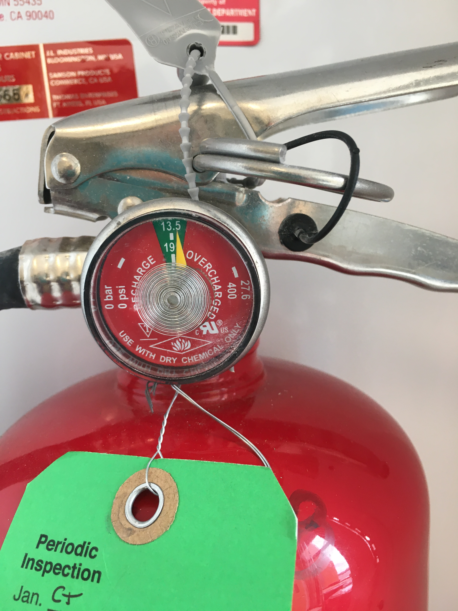
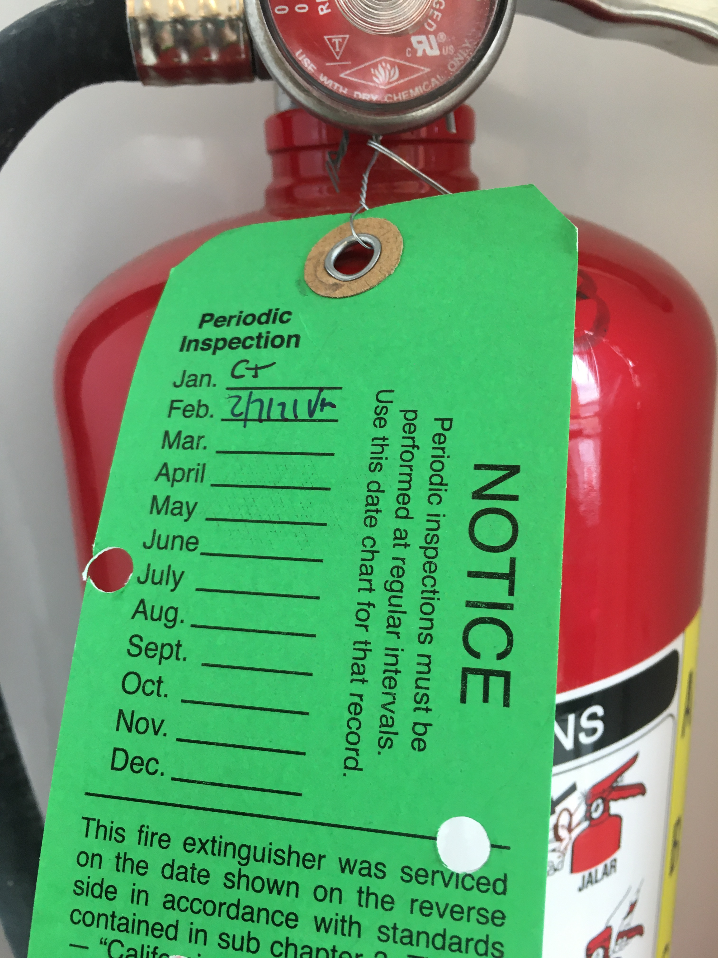
How to check fire extinguishers
Need to be checked monthly
Make sure needle is within the green range
Look at the needle as if you were looking at a meniscus of a liquid
Put date and initials of person checking on the tag
If there are issues, contact fireprevention@ucdavis.edu

Slide 4
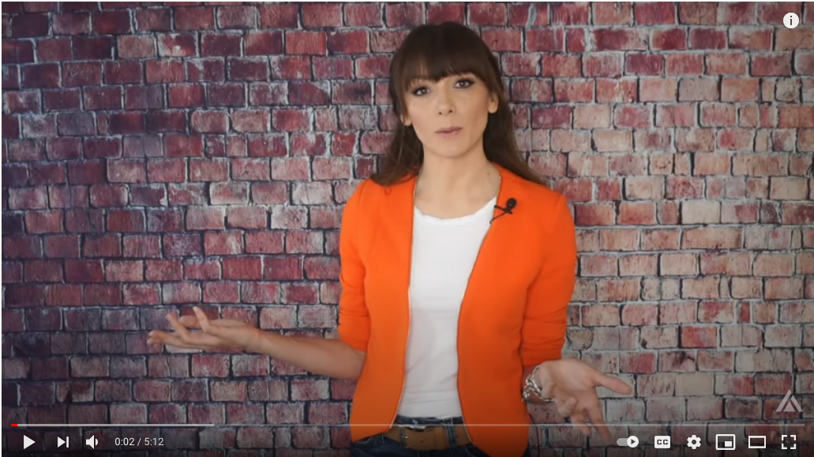
How to use a fire extinguisher
PASS
P: pull the pin (note take care not to squeeze handle)
A: aim at the base of the fire and stand back 5-6 ft
S: squeeze the handle and move carefully closer as powder is being discharged
S: sweep back and forth to cover the range of the fire
This should only be done when fire is at the beginning stage. If flames are large, evacuate. 911 should already have been alerted
Fire extinguisher will only last 20-30 seconds
https://www.youtube.com/watch?v=ONUIEMSbrog

